Slide 1
Update on renal tumors in childhood with educational cases
Norbert Graf

Slide 2
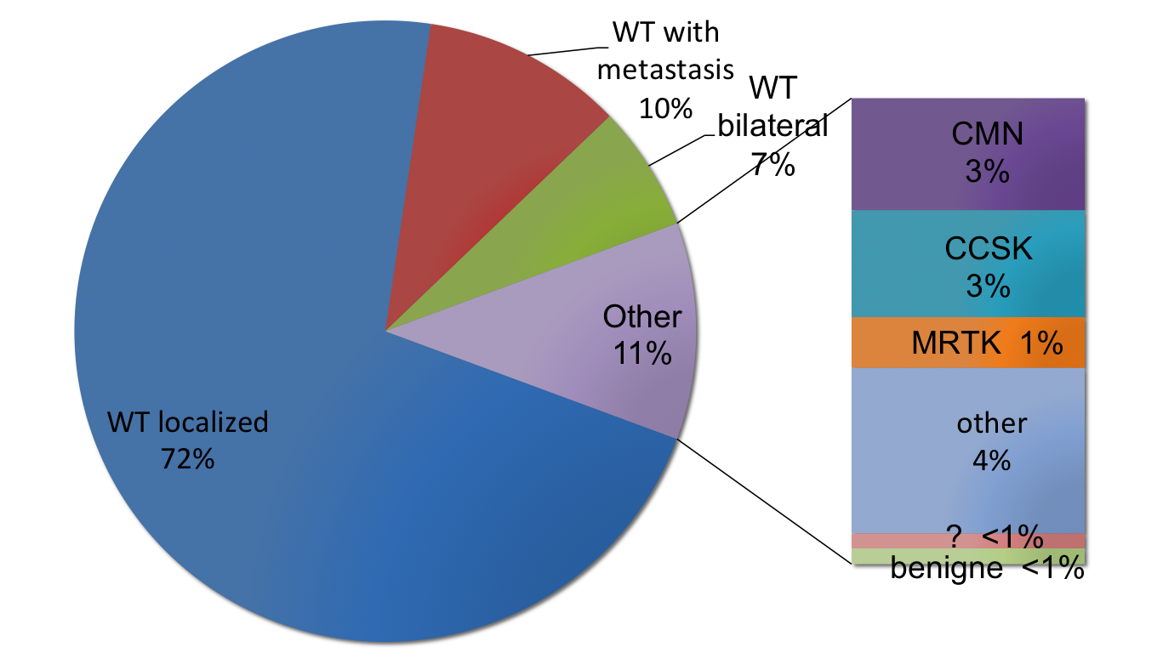
Kidney Tumors

Slide 3
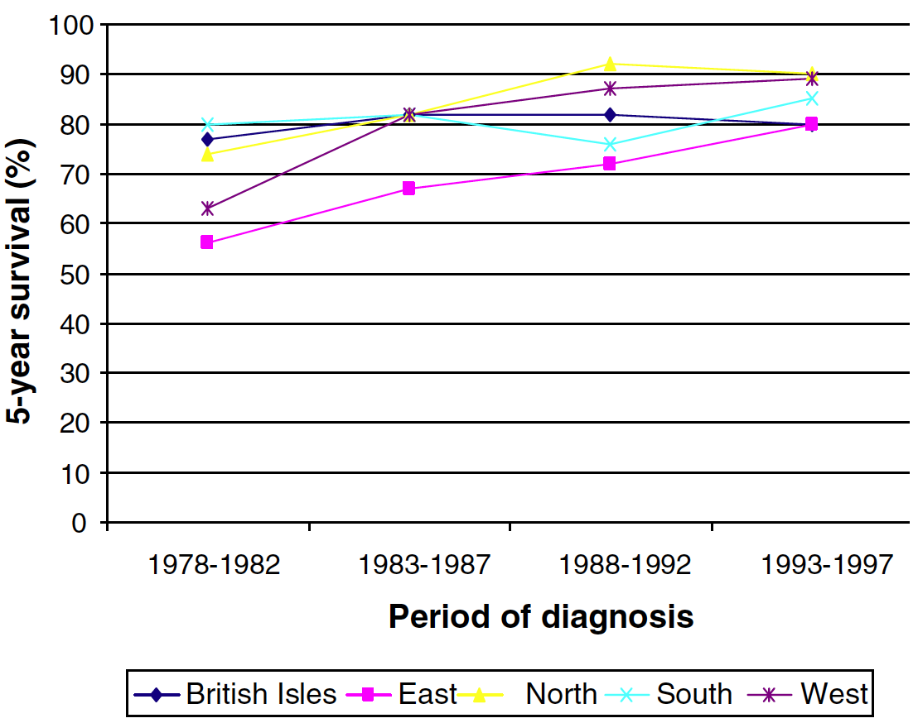
Survival of WT in Europe
Pastore G, et al.: Malignant renal tumours incidence and survival in European children (1978–1997): Report from the Automated Childhood Cancer Information System project. EJC 42:2103-2114, 2006

Slide 4
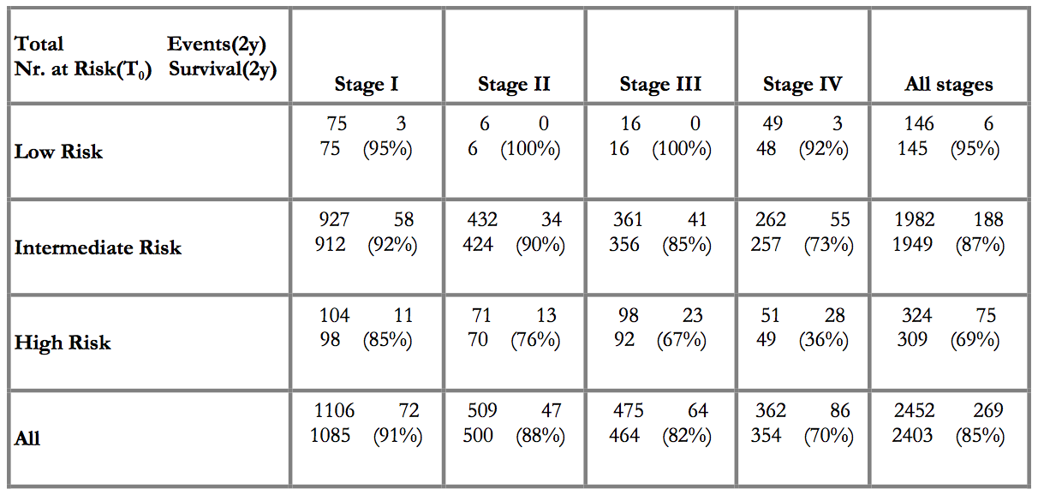
SIOP 2001 - Outcome
SIOP-RTSG, Interim Report

Slide 5
Proportion of relapses by prior treatment group (SIOP WT 2001)
Treatment | No. pts (2yr ~EFS) | No. relapse | % all relapse | No. deaths | % all deaths
VA only | 1,785 (90%) | 127 | 38% | 16 | 14%
VA+RT/AVD | 603 (88%) | 60 | 18% | 13 | 11%
4 drug arm | 225 (75%) | 47 | 14% | 29 | 25%
Stage IV | 474 (74%) | 103 | 30% | 57 | 50%
Total | 3,087 (87%) | 337 | 100% | 115 | 100%

Slide 6
1 year old

Slide 7
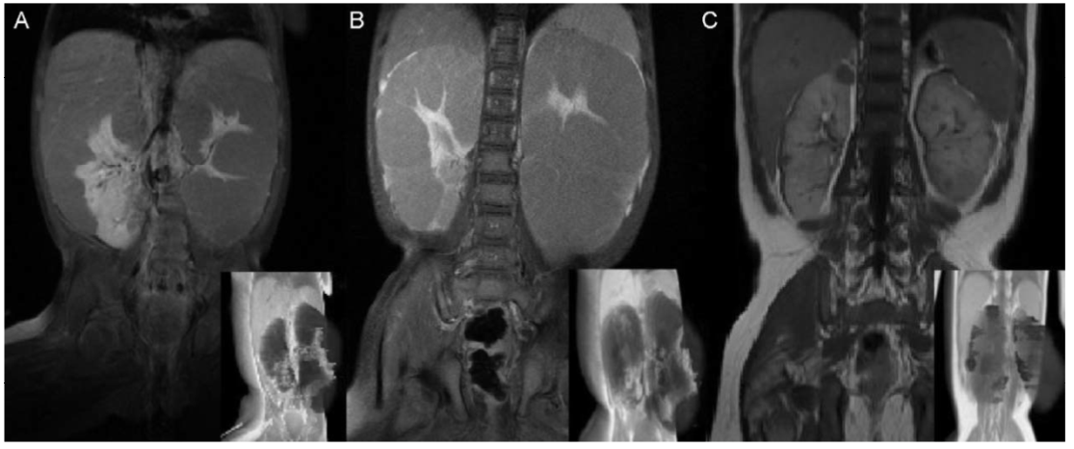
9 month old girl
Witt et al.: J Pediatr Hematol Oncol, 2009

Slide 8
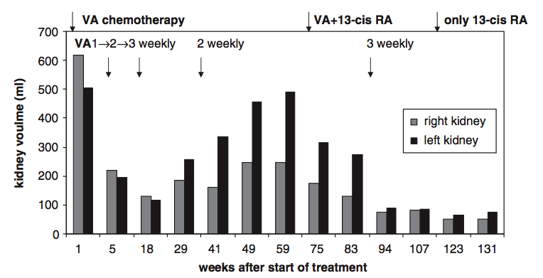
9 m, girl, Nephroblastomatosis
Witt et al.: J Pediatr Hematol Oncol, 2009

Slide 9
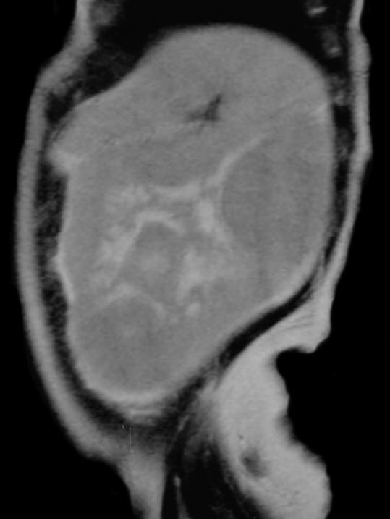
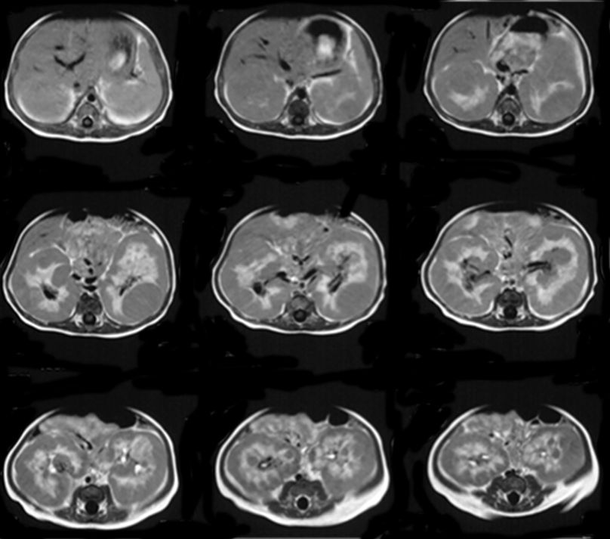
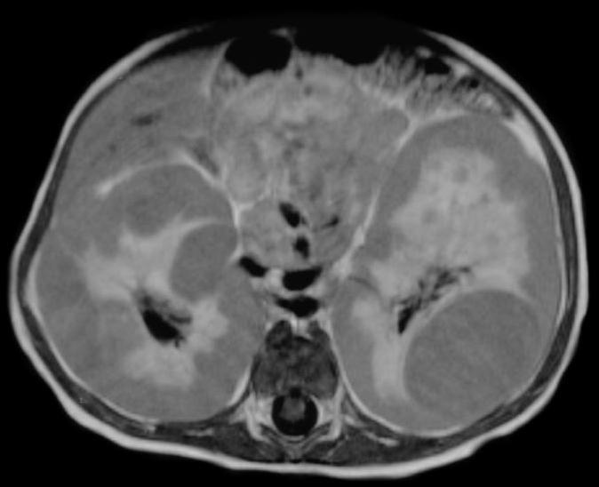
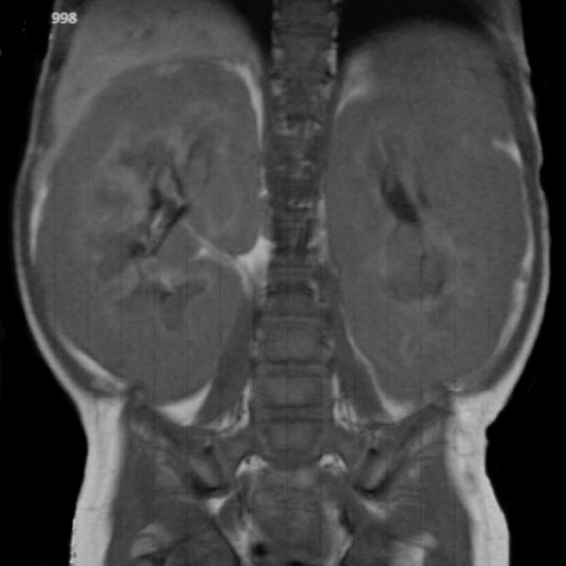
Nephroblastomatosis

Slide 10
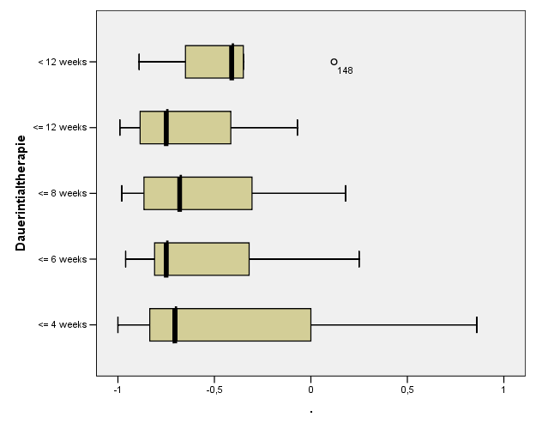
Tumor volume change

Slide 11
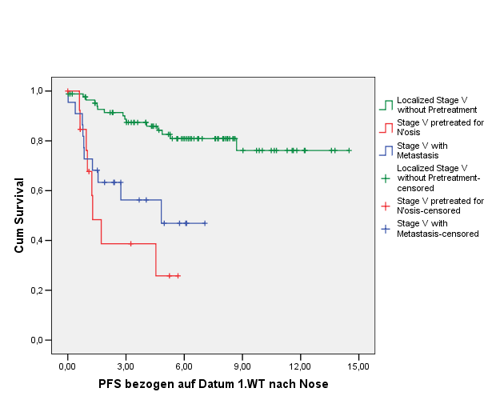
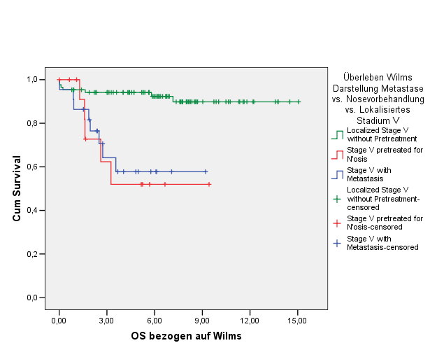
Outcome
Progression Free Survival Overall Survival
Localised Stage V: 81% (76%)
Localised Stage V: 90% (76%)
Stage V with metastasis:
58% (p<0.001)
Stage V with metastasis:
47% (p<0.001)
Localised Stage V pre-treated for
Nephroblastomatosis: 52% (p<0.001)
Localised Stage V pre-treated for
Nephroblastomatosis: 26% (p<0.001)
[YEARS]

Slide 12
Future Directions
Better Risk Stratification for better treatment
  Response to treatment
  Molecular Biology
  Imaging
Minimize acute toxicity and late effects
  Cardiotoxicity
  Nephrotoxicity
Quality Control
  Reference Centres
  ExPO-r-Net
IT-Infrastructure and Logistics
International collaboration

Slide 13
Future Directions
Better Risk Stratification for better treatment
  Response to treatment
  Molecular Biology
  Imaging
Minimize acute toxicity and late effects
  Cardiotoxicity
  Nephrotoxicity
Quality Control
  Reference Centres
  ExPO-r-Net
IT-Infrastructure and Logistics
International collaboration

Slide 14
Pathology and Biology
Tumorvolume
Stage
Histological Classification
  Percent Necrosis, Blastema, Stroma, Epithelium
Biomaterial
  Blood, Urine, Tumor, normal Kidney
  Different Areas of the tumor
    Cut them in 2 pieces→ 1 for Histology and 1 for Molecularbiology
  Culture
  DNA, mRNA, miRNA, proteomics
  →Biobanking

Slide 15
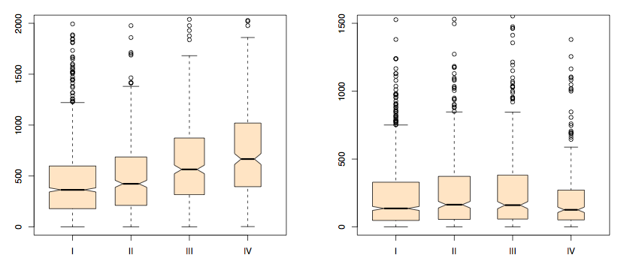
SIOP 2001 - Tumorvolume
Volume at diagnosis and stage Volume at surgery and stage

Slide 16
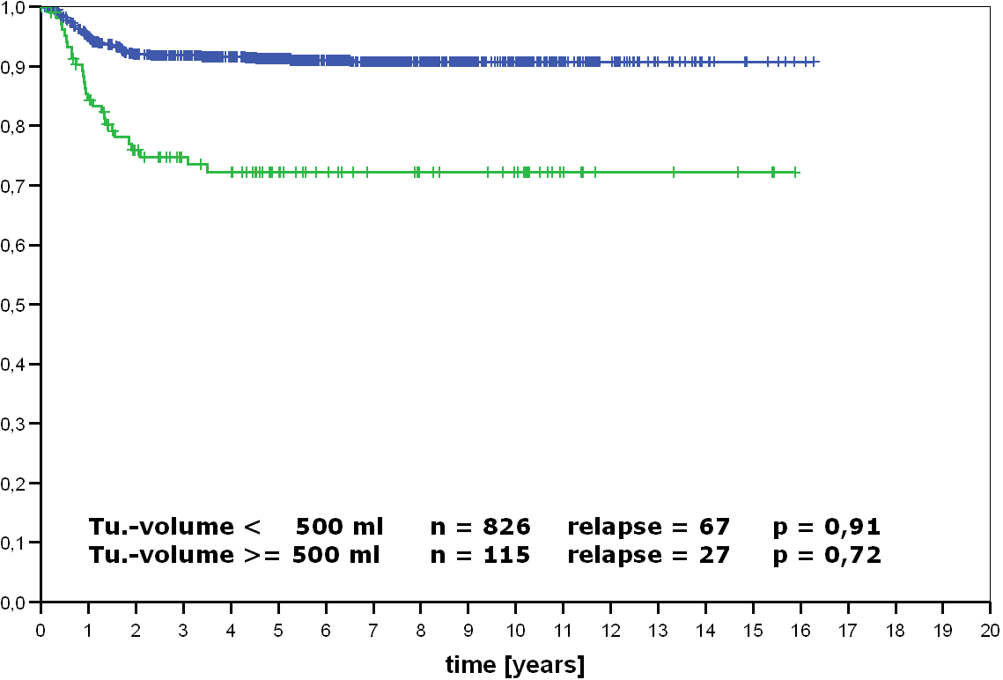
Tumorvolume (only GPOH)
after preoperative chemotherapy

Slide 17
SIOP 2001 - Tumorvolumen
Tumor volume 100 ml
Blastema: 50 ml
Tumor volume 500 ml
Blastema: 250 ml
Tumor volume 1000 ml
Blastema: 500 ml
50% Regression of viable tumour: 100% blastema
-> High risk tumour

Slide 18
SIOP 2001 - Tumorvolumen
Tumor volume 100 ml
Blastema: 25 ml
Tumor volume 500 ml
Blastema: 125 ml
Tumor volume 1000 ml
Blastema: 250 ml
50% Regression of viable tumour: 50% blastema
-> intermediate risk tumour

Slide 19
Blastemal Subtype ?
If < 2/3 of a tumor is necrotic, assign a cellular subtype
If > 2/3 of viable tumour is blastema = ‘blastemal type’
Volume after pre-op chemo | % necrosis | % blastema | Histol. Risk Group | Volume Blastema
200 ml | 60 | 70 | Blastemal | 56 ml
200 ml | 70 | 90 | Regressive | 54 ml

Slide 20
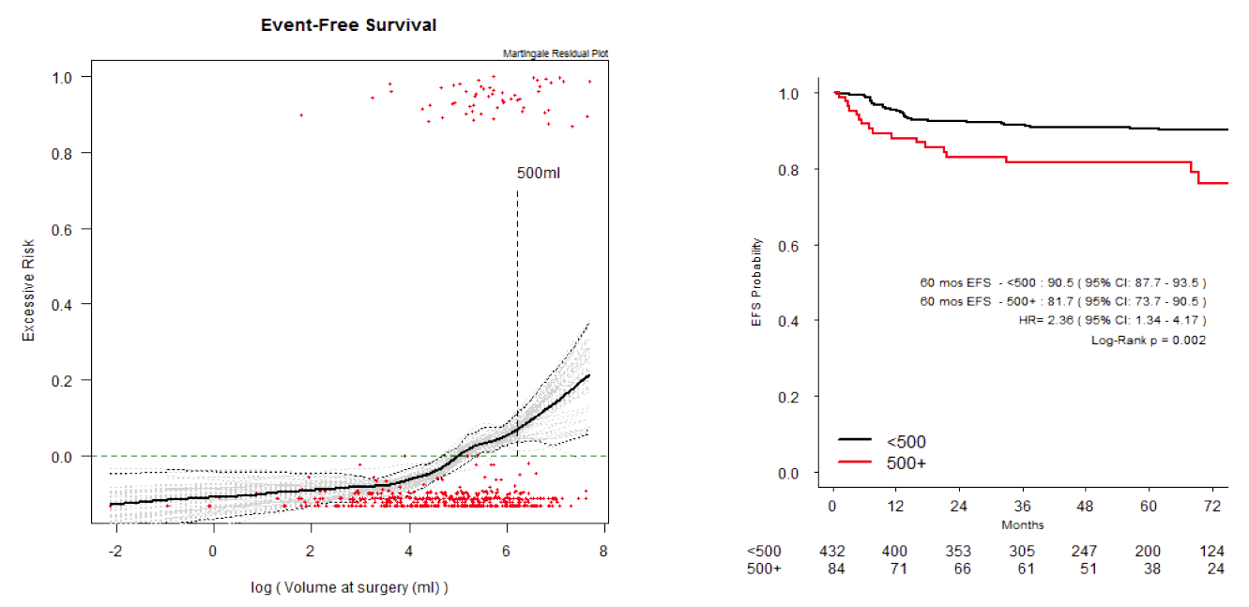
Tumor volume

Slide 21
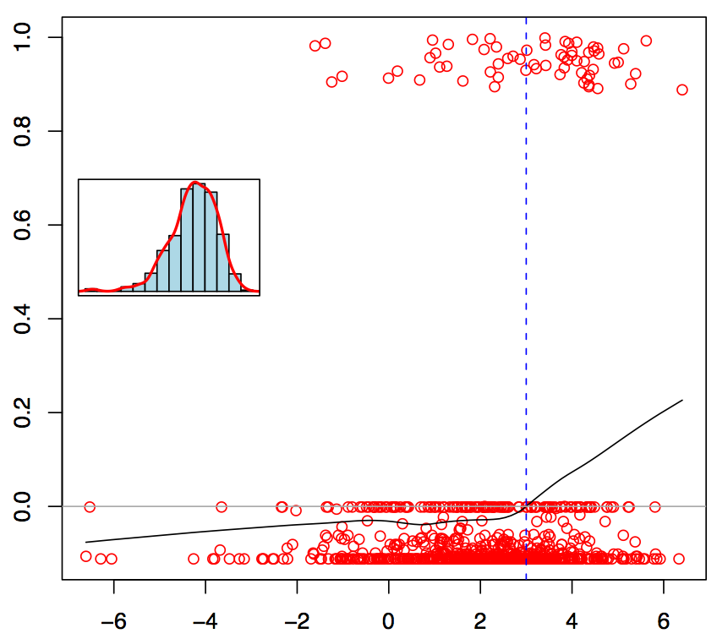
SIOP 2001 – localized WT - IR
Martingale residual plot of blastema
volume after pre-op
chemotherapy and EFS
Excessive risk (EFS)
20 ml
log(volume blastema)

Slide 22
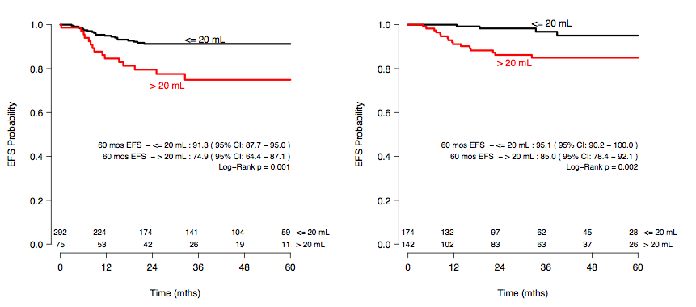
SIOP 2001 – localized WT - IR
regressive type mixed type
SIOP-RTSG, Brainstorm Meeting 2010

Slide 23
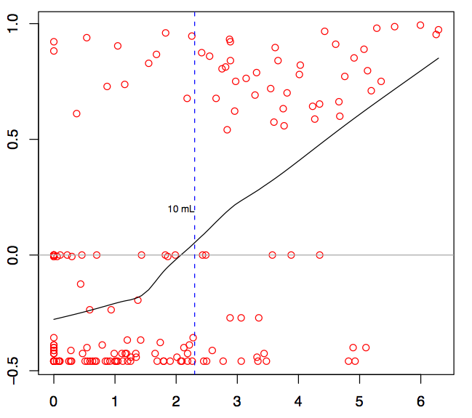
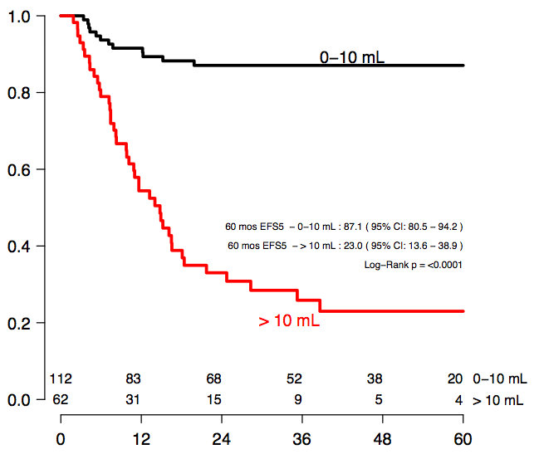
SIOP 2001 – Stage IV
Excessive risk (EFS)
EFS probability
log(volume blastema)
time (months)
SIOP-RTSG, Brainstorm Meeting 2010, 2012

Slide 24
Future Directions
Better Risk Stratification for better treatment
  Response to treatment
  Molecular Biology
  Imaging
Minimize acute toxicity and late effects
  Cardiotoxicity
  Nephrotoxicity
Quality Control
  Reference Centres
  ExPO-r-Net
IT-Infrastructure and Logistics
International collaboration

Slide 25
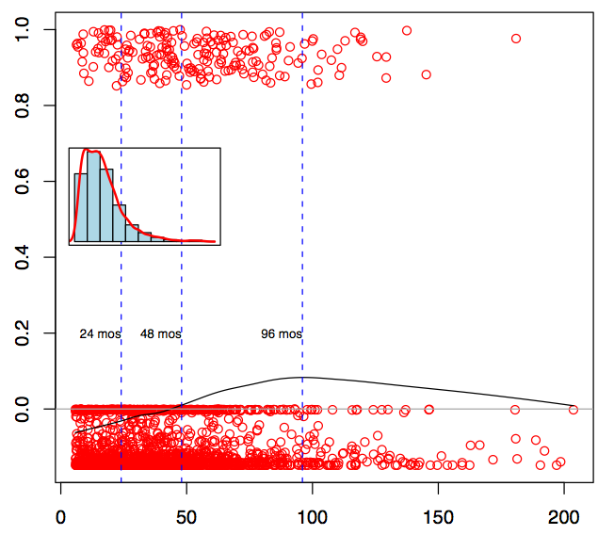
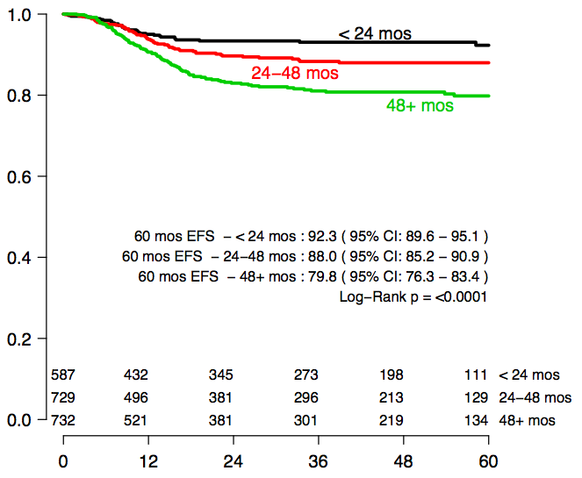
SIOP 2001 - Age
Excessive risk (EFS)
EFS probability
log(volume blastema)
time (months)

Slide 26
SIOP WT 2001 randomised trial: removal of DOX from post-op chemo of stage II/III, intermediate risk histology WT
EFS by randomised treatment (ITT)
OS by randomised treatment (ITT)
Can biology help close the OS gap?
Can biomarkers for risk stratification help close the EFS gap?

Slide 27
Spectrum of somatic mutations in Wilms
SIX1/SIX2
SIX1/SIX2
DROSHA/DGCR8
DROSHA
/DGCR8
FBXW7
WT1
11p15 epigenetic abnormalities
p53
CTNNB1
MYCN
WTX
25% no known abnormality
Chromosomal copy number gains (1q) & losses (1p/16q)
Stromal
Epithelial
Regressive, Mixed, Blastemal etc
Anaplastic & blastemal

Slide 28
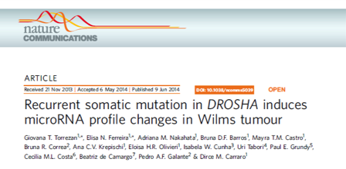
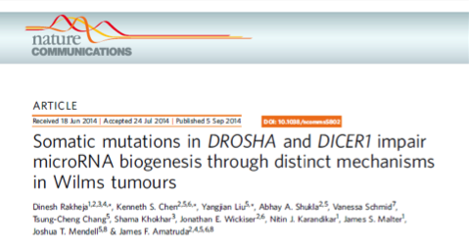
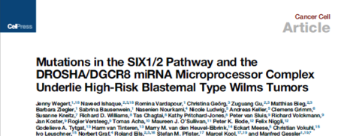
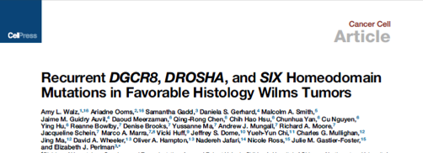
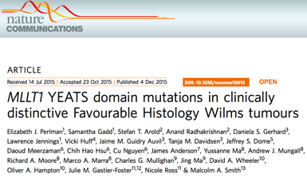


<2012: Five WT genes: WT1, CTNNB1, TP53, WTX, FBXW7 + epigenetics IGF2/H19 (11p15 locus)
2014/15: total of 12 ‘WT genes’ known: DROSHA, DGCR8, XPO5, DICER1, SIX1, SIX2, MLLT1
2017: COG TARGET study of 117 ‘high risk’ WT = relapsed FH + all diffuse anaplasia by Whole Exome/Whole Genome Sequencing:
37 genes predicted to be damaging and therefore likely WT genes
two-thirds (440/651) validation set WT had mutations in one or more of these 37 genes by direct sequencing
Nearly all (115/117) ‘discovery’ set had mutations by WES/WGS
48% (56/117) high risk ‘discovery set’ had gain of 1q

Slide 29
Frequencies of CNAs in the series
MLPA marker | Total | %
1q gain | 167 | 28%
1p loss | 49 | 8%
16q loss | 94 | 16%
1p/16q combined loss | 16 | 3%
2p gain (MYCN locus) | 88 | 15%
17p loss (TP53 locus) | 45 | 8%
4q loss (FBXW7 locus) | 24 | 4%
WT1 loss | 50 | 9%
WTX loss | 93 | 16%
None of the above | 265 | 45%
Total | 586

Slide 30
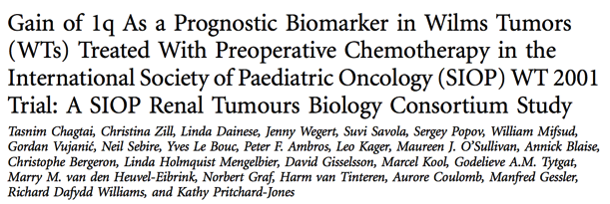
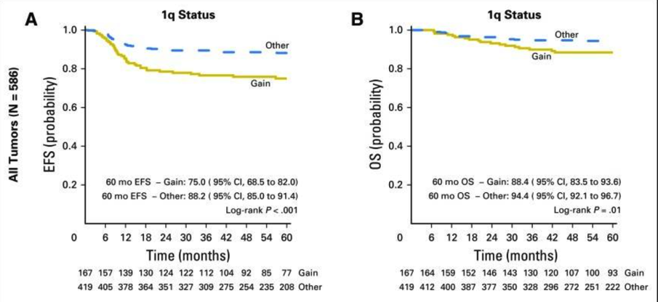
JCO (2016) 34:3195
Stage 1: signif
Stage 2: n.s
Stage 3: n.s.
Stage 4: p = 0.01
74% v. 92%
28% had 1q gain
MVA (incl. stage) RR = 2.2 (p<0.001)
MVA HR=1.98, p=0.002
MVA HR=1.61, p=0.16

Slide 31
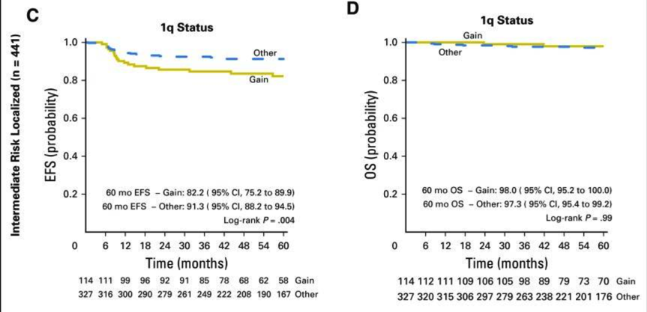
JCO (2016) 34:3195
Localised, intermediate risk histology
MVA HR=1.92, p=0.04
n.s

Slide 32

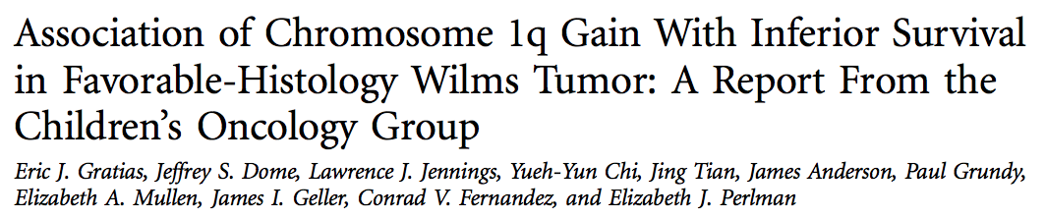
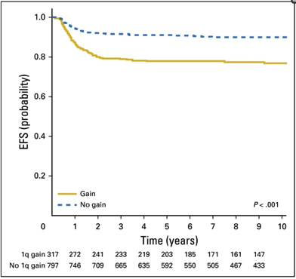
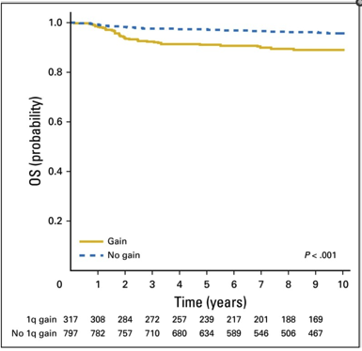
J Clin Oncol 2016 34:3189
EFS
OS
Stage 1: signif
Stage 2: n.s
Stage 3: n.s.
Stage 4: p = 0.01
74% v. 92%
28% had 1q gain
MVA (incl. stage) RR = 2.2 (p<0.001)
N = 1,114 patients from NWTSG5 informative for 1p/16q LOH and 1q gain

Slide 33
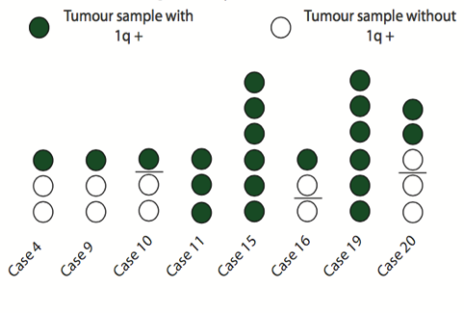
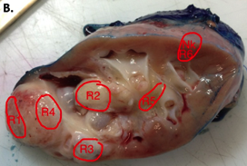
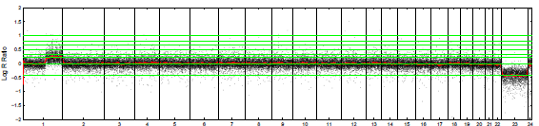

Gain of 1q is heterogeneous – Implications for tumour sampling
R1
R3
George Cresswell et al, EBioMedicine, in press

Slide 34
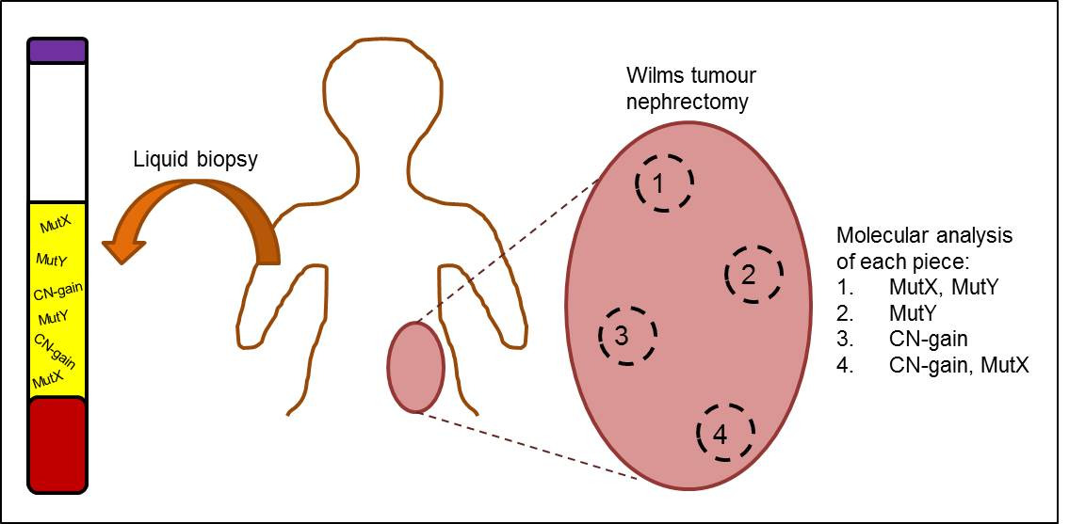
Potential for circulating cell free tumour-derived DNA to reveal the genetic landscape of Wilms tumour for diagnosis, response and follow up
5. Epigenetic change
Charlton et al, Genome Biology (2014) 15:434

Slide 35
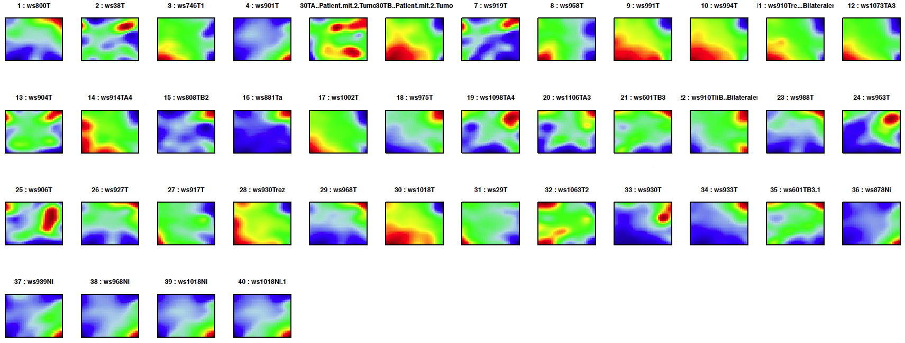
Self-Organizing Map (SOM)

Slide 36
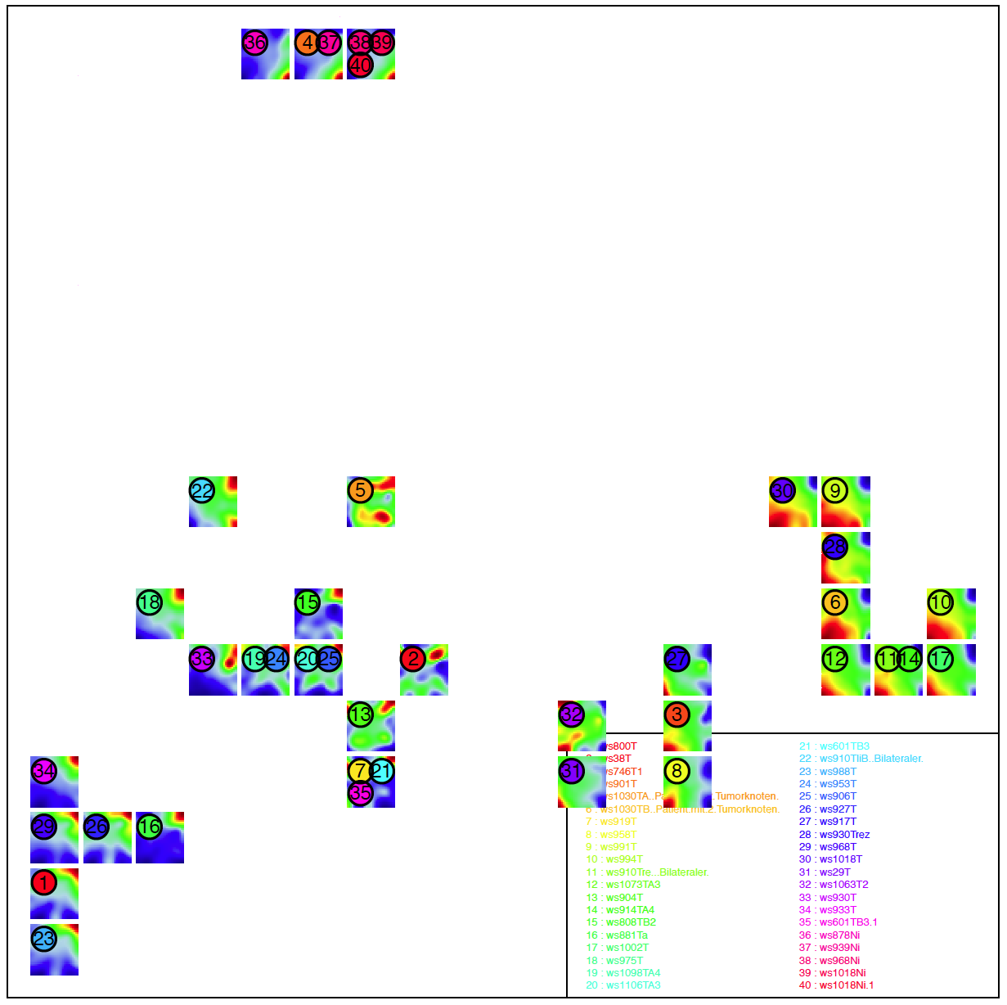
Self-Organizing Map (SOM) - 2nd level

Slide 37
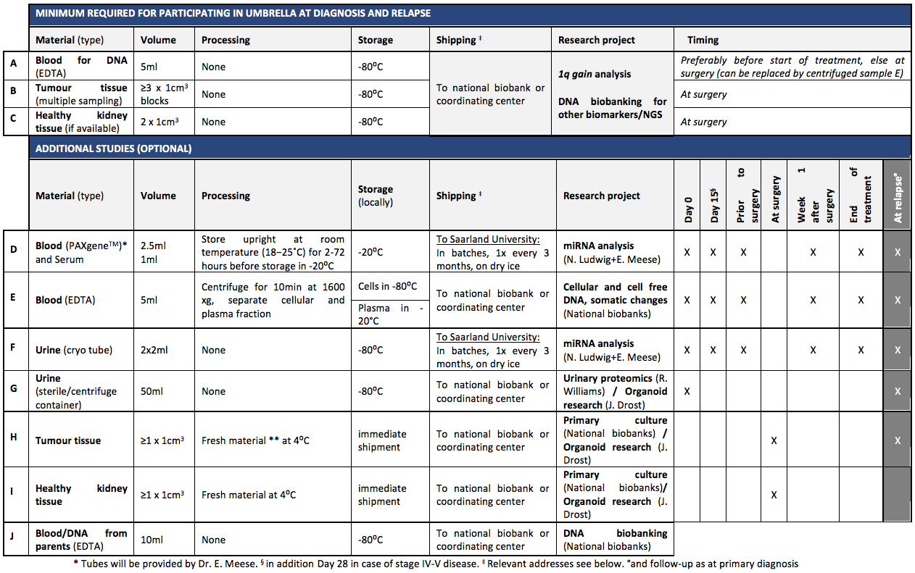
Biomaterial

Slide 38
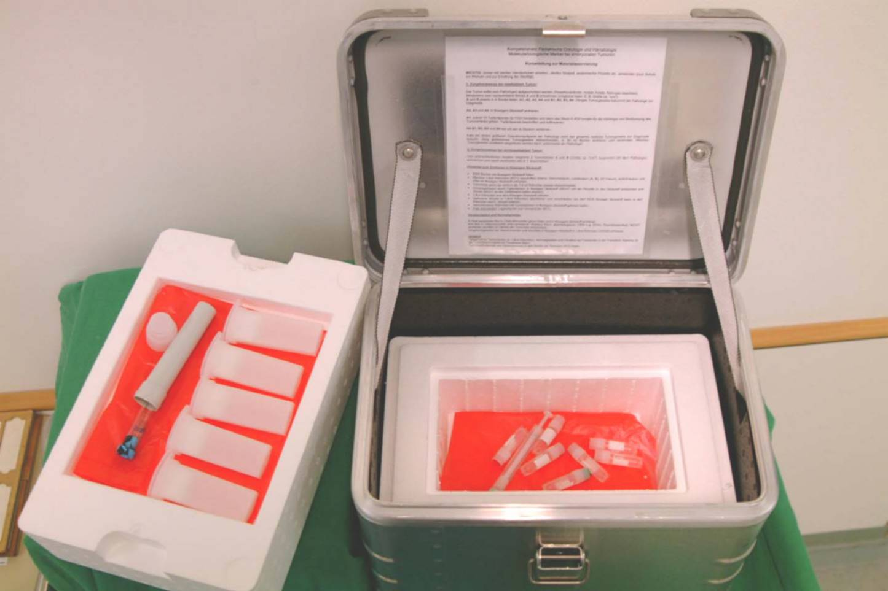
Genetics and molecular genetics
Logistics

Slide 39
Future Directions
Better Risk Stratification for better treatment
  Response to treatment
  Molecular Biology
  Imaging
Minimize acute toxicity and late effects
  Cardiotoxicity
  Nephrotoxicity
Quality Control
  Reference Centres
  ExPO-r-Net
IT-Infrastructure and Logistics
International collaboration

Slide 40
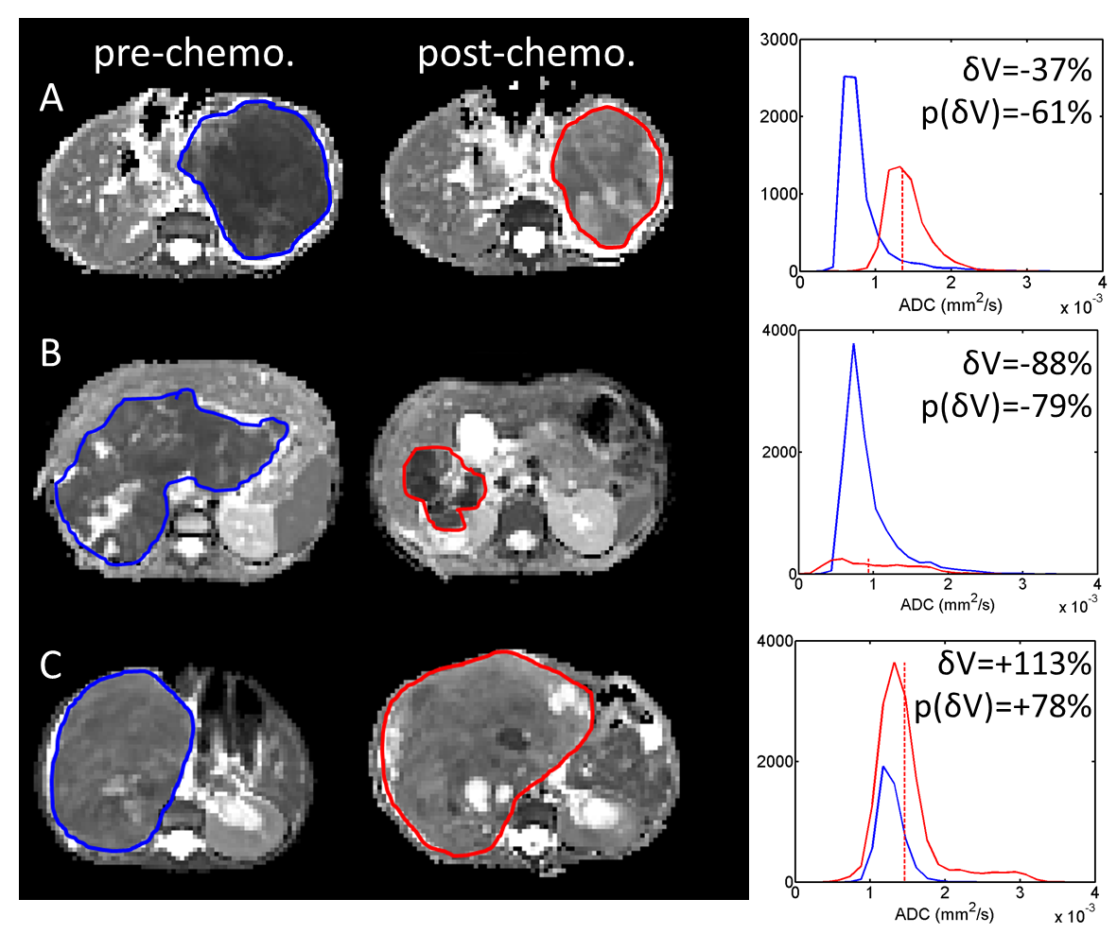
Chemotherapy-induced response in WT by DWI
Diffusivity of water molecules (ADC) is a biomarker of cellular density
ADC histograms measured in 22 Wilms’ lesions, before and after chemotherapy
Chemotherapy-induced response varies across the cohort…
Chemo. induced response
Volume ↓, ADC ↑
Volume ↓, ADC —
Volume ↑, ADC ↑
Multiple regression analysis model shows ADC histogram properties pre-chemo. may predict change in cellularity and volume of lesions post-chemotherapy.
¹Presented at the annual meeting of the British Chapter of the ISMRM, September 2012, provided by Prof. Kathy Pritchard-Jones

Slide 41
Metastatic disease (stage IV)
SIOP-2001: defined clinically significant metastases as 1cm or more, but …… response not quantified and 2/3 of children with nodules < 1cm received AVD pre-op chemo (Smets A et al).
UMBRELLA
Lung lesions >=3 mm considered metastases and should be treated with AVD – Doxo dose will be low (150mg) for complete response
Rationale: ‘CT-only’ lung lesions had poorer outcome than no lesions and AVD seems better than AV* (Grundy P et al)
(note both are observational studies!)

Slide 42
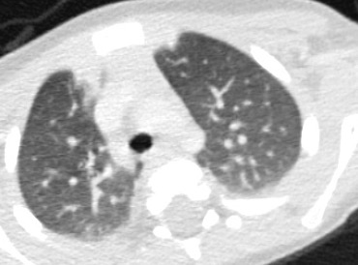
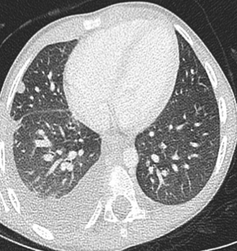
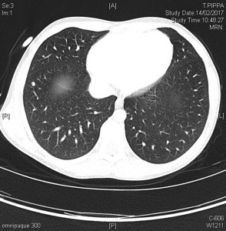
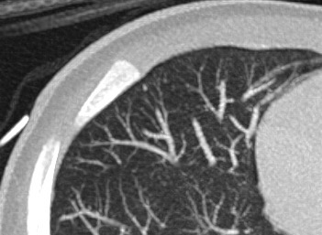
Challenge: Lung nodules
Infection/
atelectasis?
Metastasis?
Granuloma?
Nothing?

Slide 43
Future Directions
Better Risk Stratification for better treatment
  Response to treatment
  Molecular Biology
  Imaging
Minimize acute toxicity and late effects
  Cardiotoxicity
  Nephrotoxicity
Quality Control
  Reference Centres
  ExPO-r-Net
IT-Infrastructure and Logistics
International collaboration

Slide 44
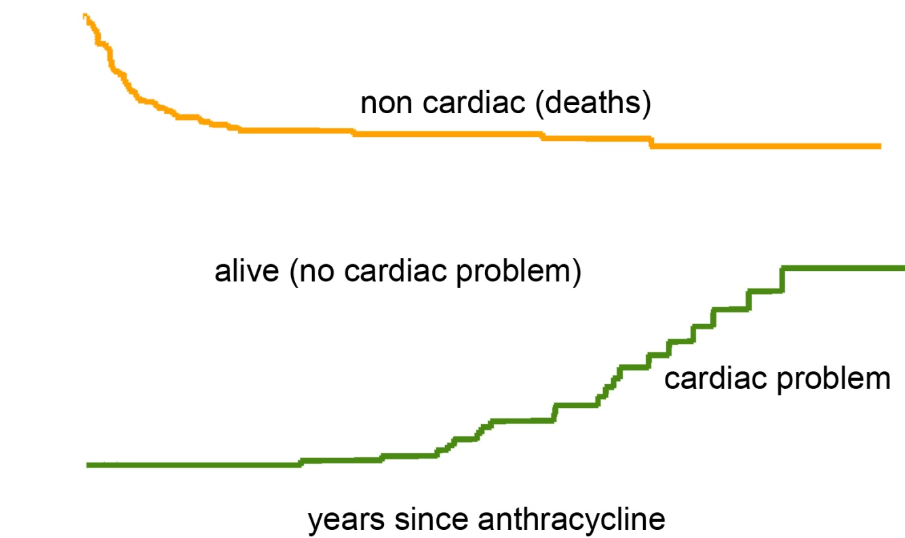
Doxorubicin Cardiotoxicity
GOSH Wilms tumour study - 1971-1990 - N=164
100
90
80
70
60
50
40
30
20
10
0
%
SF < 25%
0 5 10 15 20
years after diagnosis

Slide 45
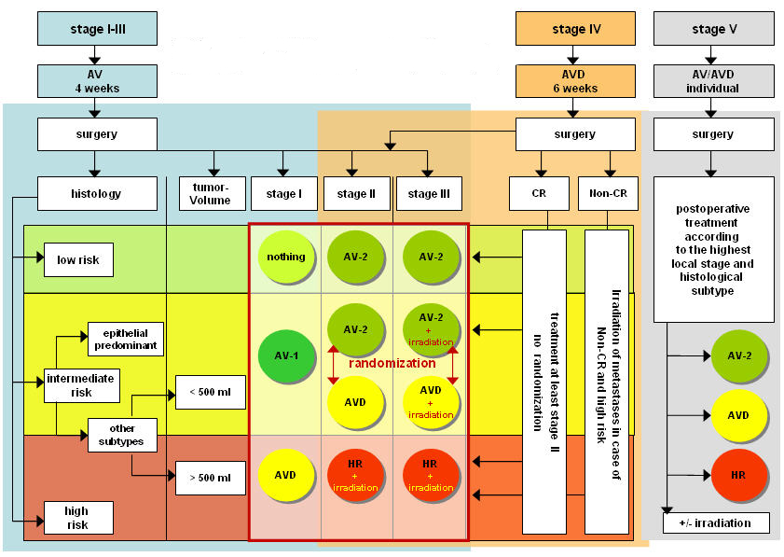
SIOP 2001

Slide 46
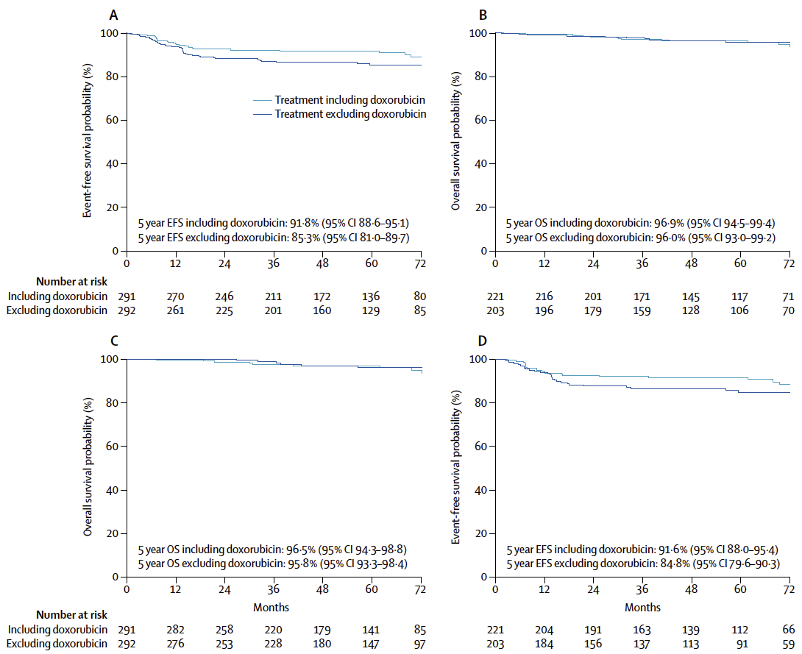
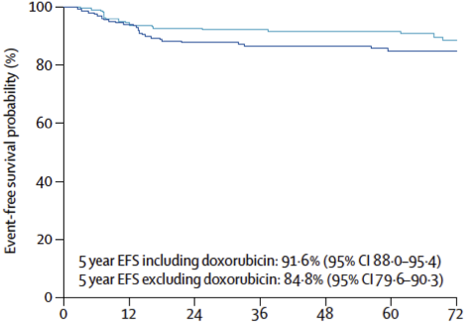
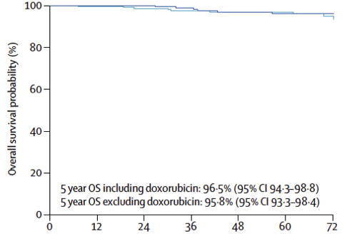
SIOP 2001
per protocol intention to treat
K. Pritchard-Jones et al.: Omission of doxorubicin from the treatment of stage II–III, intermediate-risk Wilms’ tumour (SIOP WT 2001): an open-label, non-inferiority, randomised controlled trial. The Lancet, in press 2015

Slide 47
Conclusion late effects
Our data (SIOP) show a relatively low rate of late effects after treatment of nephroblastoma. This might be due to underreporting especially for nephrotoxicity
Cardiotoxicity remains a problem
  Result of SIOP 2001 → reduction of anthracyclines
Minimizing radiotherapy remains an important step in optimizing treatment strategies
Downstaging by preoperative chemotherapy is an important factor for the reduction of late effects in nephroblastoma.

Slide 48
Future Directions
Better Risk Stratification for better treatment
  Response to treatment
  Molecular Biology
  Imaging
Minimize acute toxicity and late effects
  Cardiotoxicity
  Nephrotoxicity
Quality Control
  Reference Centres
  ExPO-r-Net
IT-Infrastructure and Logistics
International collaboration

Slide 49


Diagnosis?

Slide 50

Diagnosis?

Slide 51


Slide 52

4 weeks of preoperative CT

Slide 53


Slide 54

8 weeks preoperatice CT

Slide 55


4y 5m, girl

Slide 56


MRI Angiography

Slide 57

Metastatic disease?

Slide 58

Histology
31/113 upstaged → 27,4 %
40/140 downstaged → 28,6 %
+
18/140 wrongly diagnosed → 12,9 %

Slide 59





Histological Classification
diffuse anaplasia
ANAPLASIA ?
Quantification of regression
no or focal anaplasia
regression < 66%
=> subtyping of different tumour components
regression 66% - 99%
regression 100%
WT - regressive type
(intermediate risk)
WT - complete necrotic
(low risk)
WT – mixed type
(intermediate risk)
WT – epithelial type
(intermediate risk)
WT – blastemal type
(high risk)
WT – stromal type
(intermediate risk)
WT – diffuse anaplasia
(high risk)
WT – focal anaplasia
(intermediate risk)
Blastemal regressive mixed epithelial stromal

Slide 60
Histology
preop. chemotherapy primary surgery
CMN
3
12
CPDN
0,7
1,3
highly diff. epithelial
0,4
2,6
mixed
30,1
32,6
epithelial predominant
4,5
7,3
blastemal predominant
9,1
34
stromal predominant
7,9
1,3
post-chemotherapeutic changes
28,5
0
anaplasia
7,7
2
CCSK
5,7
2,6
rhabdoid tumor
2,1
4
35
30
25
20
15
10
5
0
%
0
5
10
15
20
25
30
35
40
Graf N et al.: The Role of Preoperative Chemotherapy in the Management of Wilms Tumor - The SIOP Studies. Urologic Clinics of North America, 27:443-454, 2000

Slide 61
Quality control
number
patients / year
hospitals
patients
n
%
n
%
< 1
52
49.1
115
13.5
1 - 4
46
43.4
489
57.4
≥ 4
8
7.5
248
29.1
all
106
100
852
100

Slide 62

Quality control
percentage

Slide 63
What to do?

Slide 64

Nephron sparing surgery (NSS)

Slide 65



Contraindication for NSS
Preoperative Tumorrupture
Abdominal Metastasis/LN positivity
Tumorthrombus
Remaining parenchyma < 50%
Multifocal tumor
Infiltration of sinus / Hematuria
Missing experience

Slide 66
Nephron Sparing Surgery (NSS)
1) SURGICAL TECHNIQUE
  NSS (A) = Partial Nephrectomy
= Resection of tumor with a rim of normal renal parenchyma
  NSS (B) = Enucleation
= Resection of tumor without a rim of normal renal parenchyma
2) SURGICAL RESECTION MARGIN (SRM)
  Intact pseudo capsule = (0)
  Doubt = (1)
  Tumor breach = (2)
3) PATHOLOGICAL RESECTION MARGIN (PRM)
  Safe rim of renal parenchyma on resection margin, except nephroblastomatosis = (0)
  Intact pseudo-capsule along the resection margin = (1)
  Tumor breach = (2)
4) REMAINING RENAL PARENCHYMA (RRP)
  A subjective evaluation is done by the surgeon of the percentage of renal parenchyma remaining
  on the operated kidney = (n %)
  For example, a polar nephrectomy usually corresponds to a RRP of 70%.
A classification for each case would be reported as follows: “NSS(X)-SRM(n)-PRM(n)-RRP(n%)”

Slide 67
One formula for each NSS
NSS (xx) - SMa (n) – HMi (n) – FR (n%)
Two Examples :
NSS A (PN) – SMa (0) – HMi (0) – FR (60%)
NSS B (En) – SMa (1) – HMi (2) – FR (90%)
 For several NSS Procedures on same kidney
2 Enucleations on the same kidney :
NSS B (En) – SMa (0) – HMi (0)
+ NSS B (En) – SMa (1) – HMi (2) – Total FR (80%)

Slide 68

Nephron Sparing Surgery
Haecker FM, von Schweinitz D, Harms D, Buerger D, Graf N: Partial nephrectomy for unilateral Wilms tumor: results of study SIOP 93-01/GPOH. J Urol 170:939-942, 2003

Slide 69
Minimal invasive surgery (MIS)
Resection must adhere to oncological principles and include lymph node sampling
Small, central tumours with rim of “normal” renal tissue
The extraction of the specimen in a bag, without morcellation, through an adequate abdominal wall incision, is mandatory, not only to control the risk of dissemination, but also to ensure adequate histopathological staging.
If a NSS is feasible, it should be preferred even if an open approach is needed.

Slide 70

Recommendation for MIS
Lateral edge of the vertebra not crossed by the tumor after chemotherapy
Easy approach of the renal pedicle

Slide 71
Future Directions
Better Risk Stratification for better treatment
  Response to treatment
  Molecular Biology
  Imaging
Minimize acute toxicity and late effects
  Cardiotoxicity
  Nephrotoxicity
Quality Control
  Reference Centres
  ExPO-r-Net
IT-Infrastructure and Logistics
International collaboration

Slide 72

Trial Biomaterial Manager

Slide 73

Biobanking Specimen CRF

Slide 74
Future Directions
Better Risk Stratification for better treatment
  Response to treatment
  Molecular Biology
  Imaging
Minimize acute toxicity and late effects
  Cardiotoxicity
  Nephrotoxicity
Quality Control
  Reference Centres
  ExPO-r-Net
IT-Infrastructure and Logistics
International collaboration

Slide 75

Participants in UMBRELLA
46 countries

Slide 76

Globalisation
Larry Hadley, Wilms Tumours in countries with less resources
SIOP Congress 2007, Mumbai, India

Slide 77


Slide 78

Summary
Stage
Histology
Response to
treatment
Biomarker
  1q gain
  others

Slide 79


Thanks for listening
downloaded from

Slide 80












Acknowledgement
From data sharing and integration
via VPH models
to personalized medicine
Enabling information re-Use by linking clinical REsearch and Care

Slide 82
UMBRELLA Protocol
Goals of SIOP-RTSG for children, adolescents and young adults with renal tumors:
  Increase survival rates
  Reduce acute and late toxicity
  Provide high quality of a standardized diagnosis, treatment and follow-up
    Independent of the tumor type,
    the socio-economic status and
    the geographic region where the patient is living
Integrated Research Protocol
Standardized Guidelines

Slide 83
Primary Aims
Feasibility of storing serial blood, urine samples, tumour and germline material
Find prognostic biomarkers in WT
  1q gain and genomic copy number biomarkers
  LOH 1p and 16q, MYCN gain, TP53 and others
  Logistics in returning results back in a relevant time frame
Blastemal volume and molecular characterization of ‘Blastema’
  Accurate measurement in real time (central pathology review)
Radiology review
  Quality of imaging, harmonization of diagnostics and treatment stratification based on central radiological review
Pathology review
  Quality of pathology, treatment stratification based on central radiological review and storage of biomaterial

Slide 84
Secondary Aims
To explore the impact on EFS or OS in WT:
  WT1, CTNNB1, AMER1, TP53, MYCN, FBXW7, GPC3, DIS3L2, DICER1, DROSHA, DGCR8, SIX1 and SIX2
To characterize at a molecular level all subtypes of WT and non-WT, using whole genome, epigenomic and proteomic approaches
To assess the feasibility of developing a targeted ‘next generation’ sequencing panel for WT
To establish a surgical review process for guiding local centers in
  Nephron sparing surgery (NSS)
  Minimal invasive surgery in unilateral renal tumours.
To perform epidemiological analyses
To validate new tools developed within the e-Health
  To improve clinical decision support

Slide 85
Expected Impact
Are biomarkers clinically relevant independent prognostic factors for WT
Better definition of high risk ‘blastemal type’
Better risk stratification for future trials
Improved infrastructure for data and samples collection enhancing translational research
Improved central radiology, pathologic and surgical review
Fostering networking between basic and clinical scientists
Provide the biological rationale for at least one phase I/II trial of a targeted therapy approach for relapsed patients

Slide 86
Treatment Guidelines
Localized WT
Metastatic WT
Bilateral disease
After primary surgery
Relapsed WT
WT in adults
Non-WT
  CCSK, RCC, MRTK, CMN
Surgical Guidelines
Radiotherapy Guidelines
Follow-up

Slide 87
Treatment unilateral WT
 |  | Tumor volume after pre- operative CT | Stage I | Stage II | Stage III
Low Risk (only CN) |  | All | No further treatment | AV2 | AV2
Intermediate Risk* |  | ≤ 500 ml | AV1 | AV2 | AV2 + RT
 |  | > 500 ml | AV1 | AVD | AVD + RT
High Risk | BT | All | AVD | HR-1 | HR-1 + RT
 | DA | All | AVD | HR-1 + flank RT | HR-1 + RT

Slide 88

Homepage

Slide 89
Future Directions
Better Risk Stratification
  Response to treatment
  Molecular Biology
  Imaging
Minimize acute toxicity and late effects
  Cardiotoxicity
  Nephrotoxicity
Quality Control
  Reference Centres
  ExPO-r-Net
IT-Infrastructure and Logistics
International collaboration
Involvement of Parent’s Groups and Long-term Survivors

Slide 90
Cases

Slide 91





Regressive subtype WT

Slide 92

Imaging

Slide 93


Response to preoperative CT
at diagnosis after preoperative CT

